Slide 1

Swisscom Network Analytics SRv6 Network Observability
21.03.2024, Thomas Graf – thomas.graf@swisscom.com Picture: Apollo 8, December 24th 1968

Slide 2


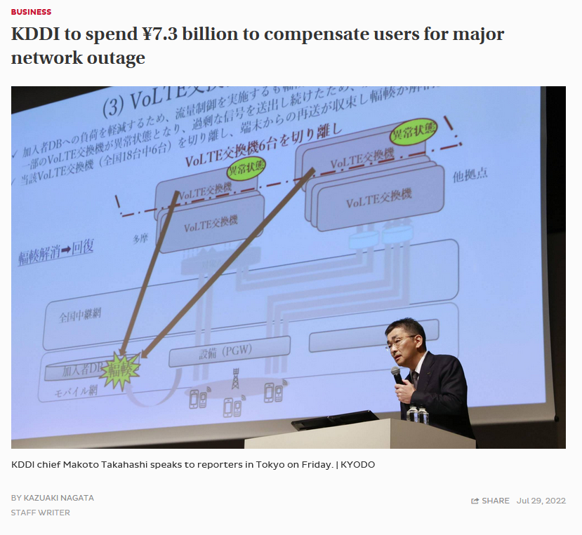


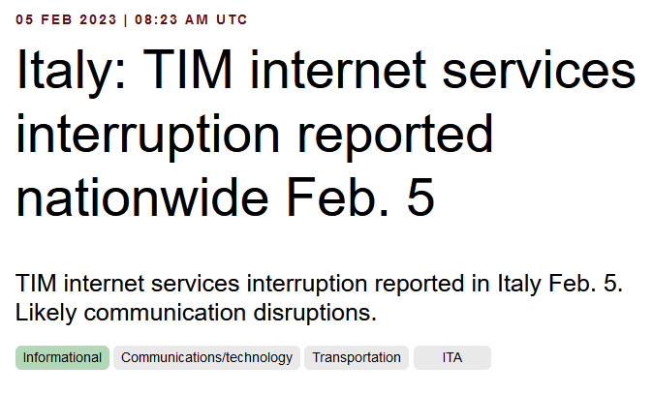

Nationwide Network Outages everywhere Increasing in impact and duration - hinting Network Visibility deficiencies

Slide 3
“ Swisscom would not have chosen SRv6 if data plane visibility wasn't implemented we would not deploy in production “

Slide 4




Network Analytics Transforms Swisscom DevOps Mindset From device monitoring to network analytics with closed loop operation
2015-2016
Flow Aggregation Proof of Concept Internet Distribution Core and TV 2.0
Platform onboarding
2017-2018
Swisscom Data Mesh onboarded, Anomaly Detection Feasibility 10 active users. 9 platforms. 87 nodes. 250'000 metrics per seconds.
IETF vendor, operator and university colaboration
2019
BMP YANG Push IETF Engagement started 40 active users. 17 platforms. 233 nodes. 1'200'000 metrics per second.
Change verification and troubleshooting
2020
Pivot Migration, Druid Scale Out, IETF collaboration established 160 active users. 34 platforms. 2500 nodes. 3'000'000 metrics per second. Active probing with 1'500'000 broadband subscribers.
Anomaly Detection
Network SLI/SLO
Network Visualization
2021
E2E Data Processing Chain Responsibility 215 active users. 40 platforms. 2700 nodes. 20'000'000 metrics per second.
Early adopters
Early majority
Late majority
Laggards
Capacity management and trend detection
2022
L3 VPN Anomaly Detection Development started 400 active users. 47 platforms. 7000 nodes. 25'000'000 metrics per second.
Key Points
From bottom up to mainstream. From IETF to Swisscom DevOps teams.
From network verification and troubleshooting to visualization with Anomaly Detection and Network SLI/SLO
From capacity management to trend detection
From network automation to closed loop operation
MPLS-SR data plane visibility since 2021, SRv6 since 2023.
2023
L3 VPN Anomaly Detection PoC started, First SRv6 network onboarded 500 active users. 51 platforms. 25000 nodes. 30'000'000 metrics per second.
2024
L3 VPN Anomaly Detection Prod Rollout 500 active users. 51 platforms. 30000 nodes. 35'000'000 metrics per second.

Slide 5
IPFIX Covering Segment Routing For MPLS-SR, SRv6 and On-path Delay
SRv6 is commonly standardized, network vendors implementations are available and network operators are at various stages in their deployments, missing data-plane visibility though.
Segment Routing coverage in IPFIX brings visibility for:
Which routing protocol provided the label or IPv6 Segment in the SR domain.
The active Segment where the packet is forwarded to in the SRv6 Domain.
The Segment List where the packet is going to be forwarded throughout the SRv6 Domain.
The Endpoint Behavior describing how the packet is being forwarded in the SRv6 Domain.
The Min, Max and Average On-path delay at each hop in the SR domain.
Export of MPLS Segment Routing Label Type Information in IPFIX https://datatracker.ietf.org/doc/html/rfc9160
Export of Segment Routing IPv6 Information in IPFIX https://datatracker.ietf.org/doc/html/rfc9487
Export of Forwarding Path Delay in IPFIX https://datatracker.ietf.org/doc/html/draft-ietf-opsawg-ipfix-on-path-telemetry

Slide 6
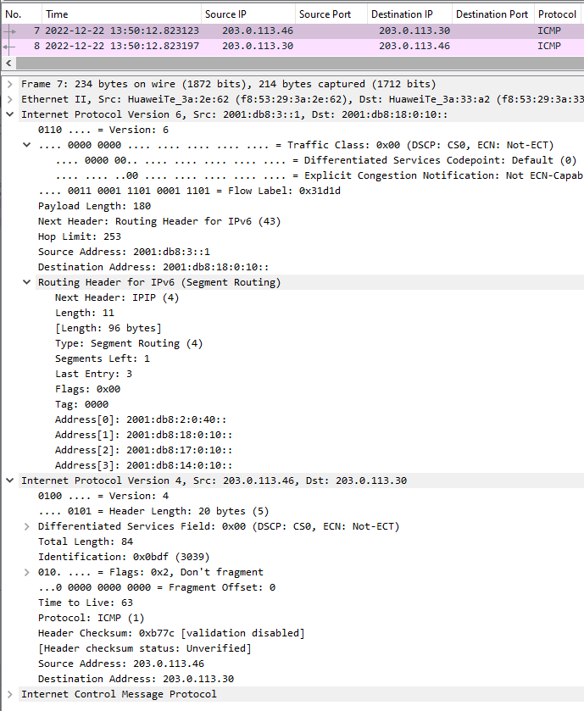
Segment Routing IPv6 Encapsulation 3 headers, one more then MPLS
Provider data-plane Divided into an IPv6 and Segment Routing Header. The IPv6 header shows from which PE to which next-hop it is being forwarded. The Segment Routing Header the list of segments this packet needs to pass through and points to the active segment.
Customer data-plane This is what we receive from the customer and encapsulate for transport through the SRv6 core.

Slide 7
Monitoring L3 SRv6 VPN's with IPFIX and BGP Monitoring Protocol From L3 VPN Inventory to Realtime Network Analytics
From an inventory perspective, Connection Points are connected through Logical Connections.
From a BGP control-plane perspective, IPv4/6 unicast prefixes in VRF's are tagged with BGP standard communities.
One BGP standard community to identify the Logical Connection. One BGP standard community to identify each Connection Point.
When IPv4/6 prefixes are exported from VRF's, a BGP route-distinguisher, BGP extended community route-targets, a SRv6 VPN SID for the IPv6 next-hop is allocated.
From a forward-plane perspective, when IPv4/6 unicast traffic is received from the edge at the SRv6 PE, a lookup is performed, the SRv6 VPN SID is obtained and IPv6 next-hop is added when forwarded to the core.
Daisy collects SRv6 provider data-plane, IPv4/6 unicast customer data-plane in IPFIX and at provider edge BGP VPNv4/6 unicast to perform real-time data correlation.

Slide 8




Trace Path and Measure Delay in IPv6 Data Plane Use Case Overview
Traffic to Measure
Active probing addresses what-if and Hybrid Type 1 passive customer packet delay and loss SLI.
Delay Measurement
Measure on-path or round-trip delay observed on network node or outside network node.
Network Dimensions
Ability to trace packet forwarding path to describe which interfaces, queues, nodes and domains the flow was forwarded through due to which IP next-hop, top MPLS label or active SRv6 SID. Ability to trace a single or group of flows with same properties.
IPv6 Data Plane Applicability
Applied to IPv6 Destination or Hop-by-Hop options header and observable on transit and encapsulation or decapsulation node only.
Data Aggregation
Delay measurement and trace dimensions are control and management plane aggregated on network node (postcard) or accumulated in the IPv6 packet across the forwarding path (passport) and aggregated outside network node.

Slide 9
Measure delay and give network context Enabling a statistical network delay view
Packets are captured ingress with an optional sampler, data-plane dimensions extracted, enriched with device and control-plane dimensions and added with a unique flow ID to a flow cache on the node for aggregation.
The data-plane dimensions answers which packet. The control-plane which service. The device dimensions where in the network.
In case of On-Path Delay Measurement, a direct export marking bit and optionally a timestamp is added to the packet header when entering the IOAM domain.
Each subsequent packet for the same flow increases byte and packet count. Each new flow creates a new flow ID in the flow cache.
In case of On-Path Delay Measurement, At each node in transit (postcard) or only at the last node (passport), the delay is calculated by comparing the timestamp in the packet and when packet is received on the node. Delay is populated into the flow cache besides packet and byte count.

Slide 10

Trace Path and Measure Delay in IPv6 Data Plane Use Case Applicability
 | STAMP TWAMP Light | Path Tracing | Alternate Marking | Enhanced Alternate Marking | IOAM Trace Option Type | IOAM Proof of Transit | IOAM Edge to Edge | IOAM Direct Export
Active (what if) measurement | x | x
Hybrid Type 1 (Connectivity SLI) measurement |  |  | x | x | x | x | x | x
Measure on-path delay | x | x | x | x | x | x | x | x
Measure round trip delay | x
Delay measured on network node | x |  |  | x |  |  | x | x
Delay measured outside network node |  | x | x | x | x | x
Trace domains being forwarded through |  |  |  |  | x | x |  | x
Verifies that specified forwarding path is used |  |  |  |  |  | x
Trace nodes and interfaces being forwarded trough |  | x | x | x | x | x |  | x
Trace next-hop, top MPLS label or active SRv6 SID |  |  | x | x |  |  |  | x
Ability to trace single flows |  |  |  | x |  |  |  | x
Applied to IPv6 Destination Options Header |  | x |  |  |  |  | x
Applied to IPv6 HbH Options Header |  | x | x | x | x | x |  | x
Ability to aggregate on network node | x |  | x | x |  |  | x | x
In packet aggregate able |  | x |  |  | x | x
Main Objectives
Between VPN endpoints we need to understand which forwarding path is used.
Between VPN endpoints we need to understand where the delay is being accumulated and why.

Slide 11
Network Observability in SRv6 Status, Charter Aspect and Summary
Status
BGP Monitoring Protocol is BGP Address Family agnostic. Enables visibility in the SRv6 overlay BGP control plane.
RFC 9487 adds SRv6 dimensions in IPFIX entities. Enables visibility in the SRv6 data plane.
draft-ietf-opsawg-ipfix-on-path-telemetry adds delay measurements in IPFIX entities. Enables visibility into the on-path delay.
RFC 9378 defines IOAM. RFC 9341 defines Alternate Marking. draft-gfz-opsawg-ipfix-alt-mark and draft-spiegel-ippm-ioam-rawexport adds Alternate Marking and IOAM dimensions in IPFIX. Enables tracing visibility in the packet forwarding.
Charter Aspect
Scope: SRv6 network management guidance: Configuration, observability, assurance, and performance optimization.
Key Deliverables: SRv6 network management guidance for configuration, automation, observability, assurance, performance optimization, and troubleshooting.
Summary
The key asset of SRv6 is that at the source of the packet generation the forwarding path can be decided. To validate source routing, on-path visibility is a necessity. However, the protocols involved are still in development phase, major vendors did not implement, and no requirement document has been written by an operator yet. SRV6OPS contributes by not only outlining the use cases, objectives and specifying the requirements but also feedback on implementations.

Slide 12
Backup

Slide 13

Network Data Collection with Network Telemetry Structured metrics enable informed decision-making
Network Telemetry:
A data collection framework where the network device pushes its metrics to Big Data. Defined in RFC 9232.
Data Modelling:
Key for Big Data correlation to understand and react in the right context
Are interface drops bad?
How should we react?

Slide 14



Network Anomaly Detection
Answers
What changed and when, on which connectivity service, and how does it impact the customers?
Focuses
Provides meaningful connectivity service impact information before customer is aware of and support in root-cause analysis.
Data Mesh
Consumes real-time Forwarding-Plane, Control-Plane and Management-Plane metrics and produces analytical alerts.
Direction
From connectivity service to network platform.
For inventoried L2 or L3 VPNs, Network Anomaly Detection constantly monitors and detects any network or device topology changes, along with their associated forwarding consequences for customers. Notifications are sent to the Network Operation Center before the customer is aware of service disruptions. It offers operational metrics for in-depth analysis, allowing to understand on which platform the problem originates and facilitates problem resolution.

Slide 15

Network Service Level Indicator and Objective
Answers
How much budget is left on a connectivity service? Does redundancy exist on all connection points? Is it safe to perform a maintenance window?
Focuses
Service connectivity state and how far state objectives are being fulfilled or not.
Data Mesh
Consumes real-time Forwarding-Plane, Control-Plane and Management-Plane metrics and produces analytical SLI metrics and SLO alerts..
Direction
From connectivity service to network platform.
For inventoried L2 or L3 VPNs, forwarding-plane loss and latency objectives (SLO) are established for each Quality of Service (QoS) class in accordance with customer Service Level Agreement (SLA) criteria. Notifications of Service Level Objective (SLO) violations, along with the state of control-plane redundancy, management-plane interface and BGP peering, are raised when forwarding-plane loss or latency objectives are at risk of not being met. These notifications assist network reliability engineering and collaborating relevant platform team to quickly identify and resolve the issue.

Slide 16
BMP Covering all RIB's Extends much needed RIB coverage
BGP route exposure without BMP is a challenge of the first order:
Only best path is exposed (missing best-external and ECMP routes)
Next-hop attribute not preserved all the time
Filtering between RIB's not visible
Support for Local RIB in BGP Monitoring Protocol https://datatracker.ietf.org/doc/html/rfc9069
Support for Adj-RIB-Out in BGP Monitoring Protocol https://tools.ietf.org/html/rfc8671
Adj-RIB-Out an RFC since November 2019. Local RIB since February 2022. Juniper, Huawei and Nokia have public releases available supporting both. Cisco has test code available but haven't released yet.

Slide 17
BMP with extended TLV support Brings visibility into FIB's and route-policies
Knowing all the routes in all the RIB's brings the new challenge
That we don't know how they are being used in the FIB/RIB (which one is best, best-external, ECMP, backup)
That we don't know which route-policy permitted/denied/changed which prefix/attribute
TLV support for BMP Route Monitoring and Peer Down Messages https://tools.ietf.org/html/draft-ietf-grow-bmp-tlv
Support for Enterprise-specific TLVs in the BGP Monitoring Protocol https://tools.ietf.org/html/draft-lucente-grow-bmp-tlv-ebit
BMP Extension for Path Marking TLV https://tools.ietf.org/html/draft-cppy-grow-bmp-path-marking-tlv
Logging of routing events in BGP Monitoring Protocol https://datatracker.ietf.org/doc/html/draft-ietf-grow-bmp-rel
For IETF 110 Hackathon, IETF lab network with Big Data integration has been further extended to collaborate development research with ETHZ, INSA, Cisco, Huawei and pmacct (open source data-collection by Paolo Lucente).

